Slide 1
A Comprehensive Analysis of K-Means Clustering and Evaluation Metrics
Course Work 3_CST4050
Keerthana Jothi
Date: 27/02/2025

Slide 2
Introduction to Clustering
What is Clustering?
Clustering is an unsupervised learning technique used to group similar data points.
Commonly used in customer segmentation, image processing, and pattern recognition.
Objective: Identify inherent groupings in data.
Clustering Method Used
K-Means Clustering:
A centroid-based algorithm that partitions data into K clusters.
Each data point is assigned to the nearest centroid, and centroids are updated iteratively.
Chosen for its simplicity and efficiency in handling large datasets.

Slide 3
Selected Evaluation Methods
Silhouette Score:
Measures how similar a data point is to its own cluster compared to other clusters.
Ranges from -1 to 1; higher values indicate better-defined clusters.
Davies-Bouldin Index (DBI):
Evaluates the average similarity ratio of each cluster with its most similar cluster.
Lower values indicate better clustering performance.

Slide 4
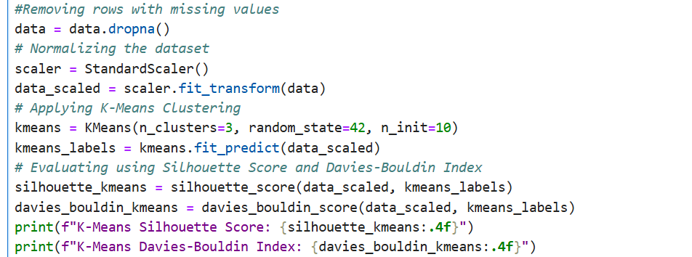

Initial K-Means Performance
Initial K-Means Clustering Results

Slide 5
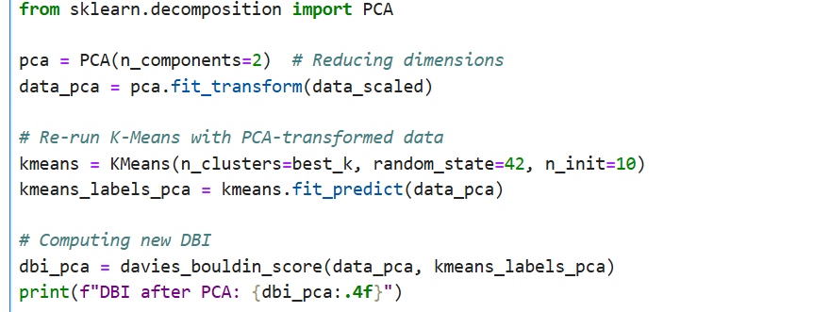

PCA Transformation and Re-evaluation
Applied PCA to reduce dimensions to 2 for better visualization and clustering performance.
Re-ran K-Means on PCA-transformed data.
New Silhouette Score: 0.4384 (improved)
New DBI after PCA: 0.8169 (significantly improved)

Slide 6
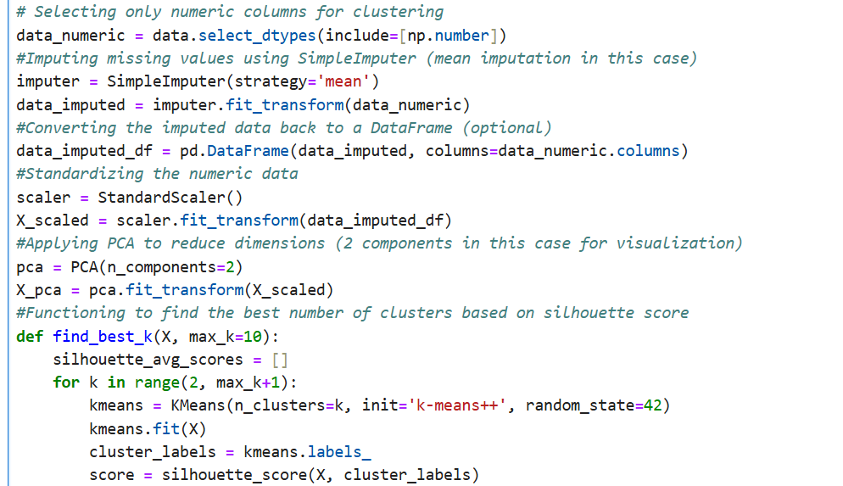
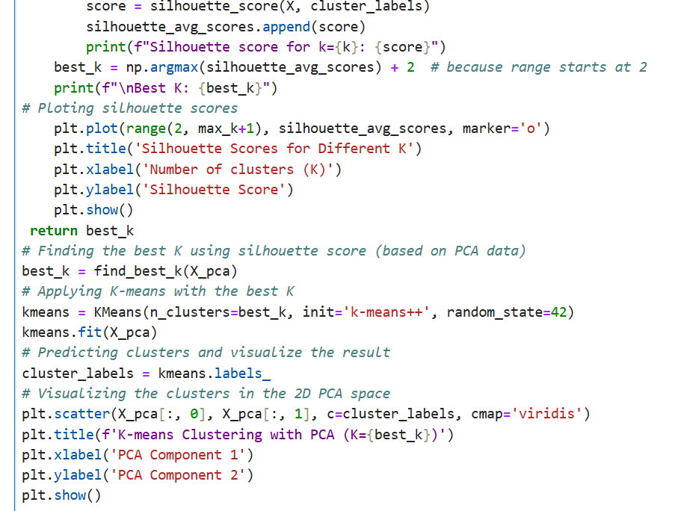
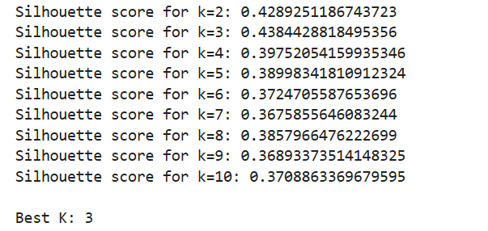

Slide 7
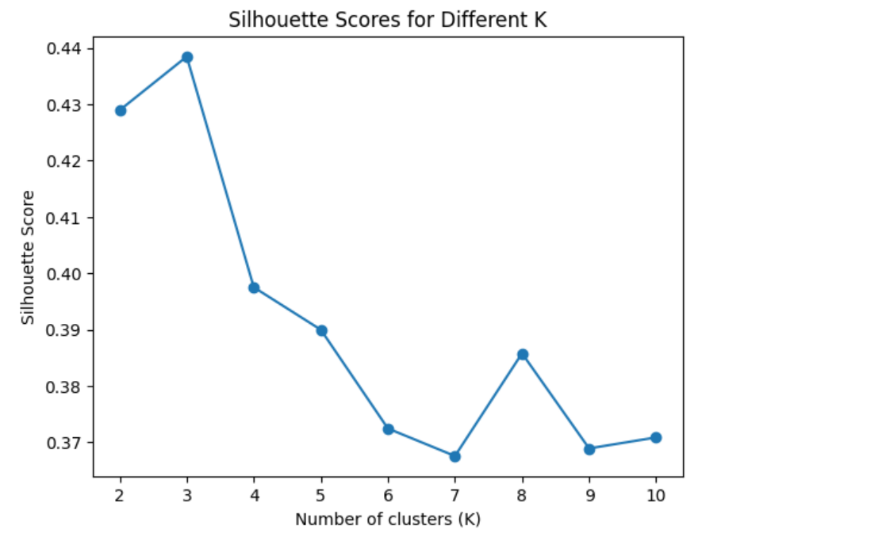
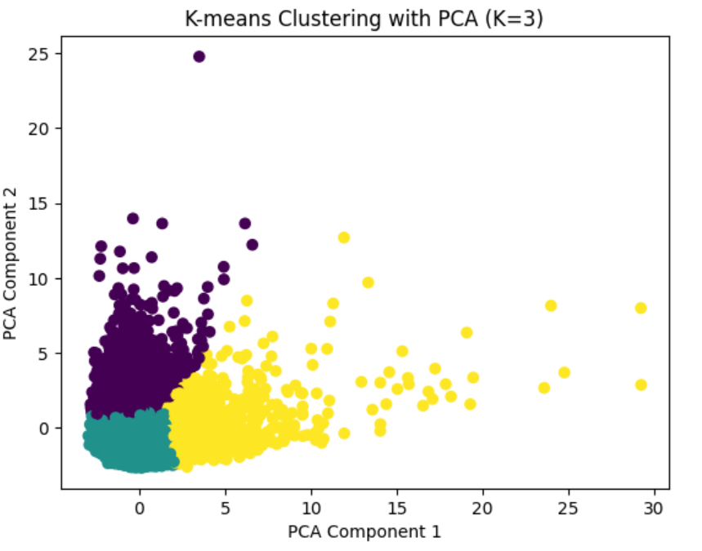

Slide 8
Improvements Made
Enhancements made for Better Clustering
Dimensionality Reduction:
Applied PCA to reduce data dimensions, improving clustering performance.
Hyperparameter Tuning:
Experimented with different values of K to find the optimal number of clusters.
Data Preprocessing:
Handled missing values and normalized data to ensure better clustering results.

Slide 9
Conclusion
K-Means clustering provided valuable insights into customer behavior.
Evaluation metrics like Silhouette Score and DBI are essential for assessing clustering quality.
Improvements led to better-defined clusters and more meaningful insights.

